Slide 1
Lecture 6
Network Models of Cities
6.1 Scale Invariance and Urban Scaling
IUS 3.1, 3.2
© Luís M. A. Bettencourt 2023

Slide 2
Network Effects
The value of a network is proportional to the number of its connections
Connections grow faster than proportionally to the number of nodes
$$Y∼N^{2}$$
Metcalfe’s Law
Can this happen for cities?

Slide 3
Cities !!
What does data say about their properties ?
IUS 3.2
Notes:
After some build up we will now look at some urban data to establish some of the most important properties of cities.

Slide 4
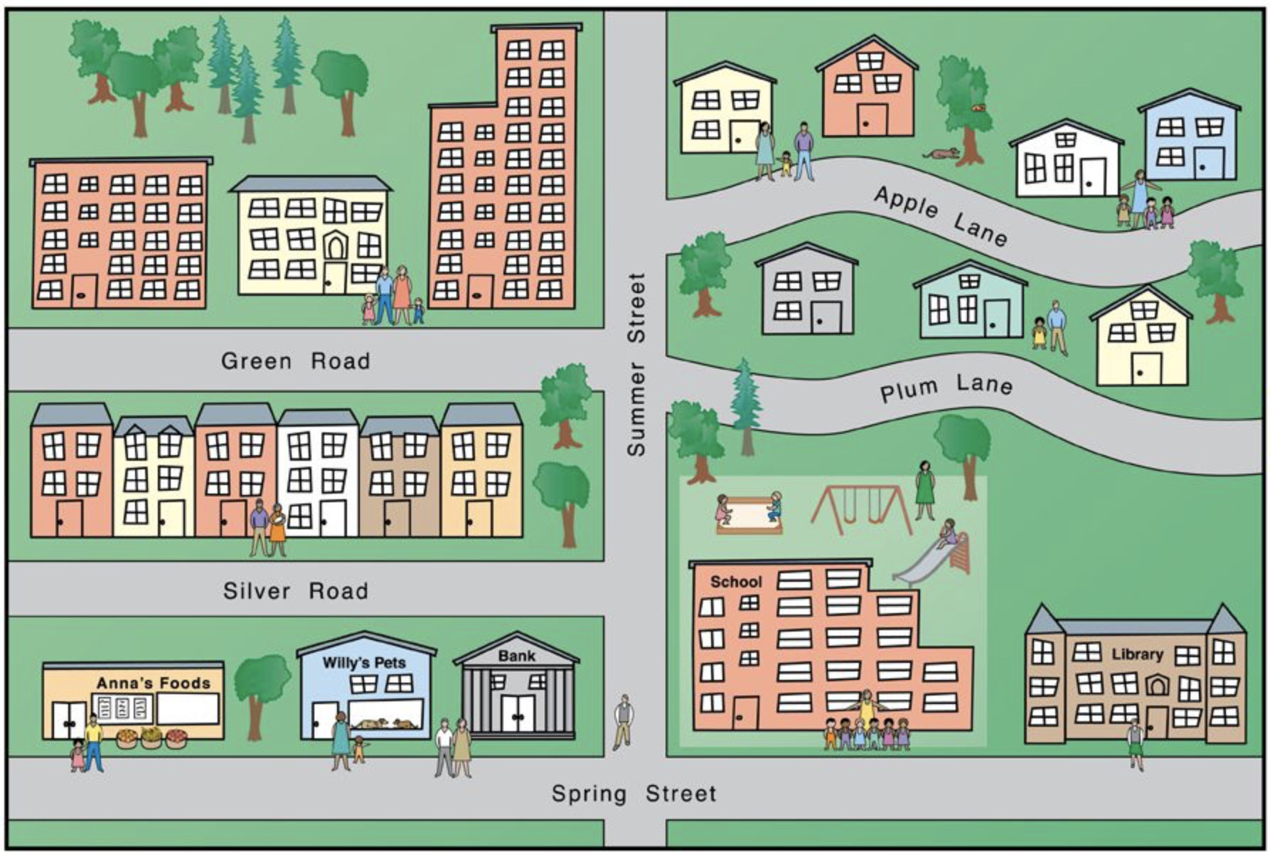
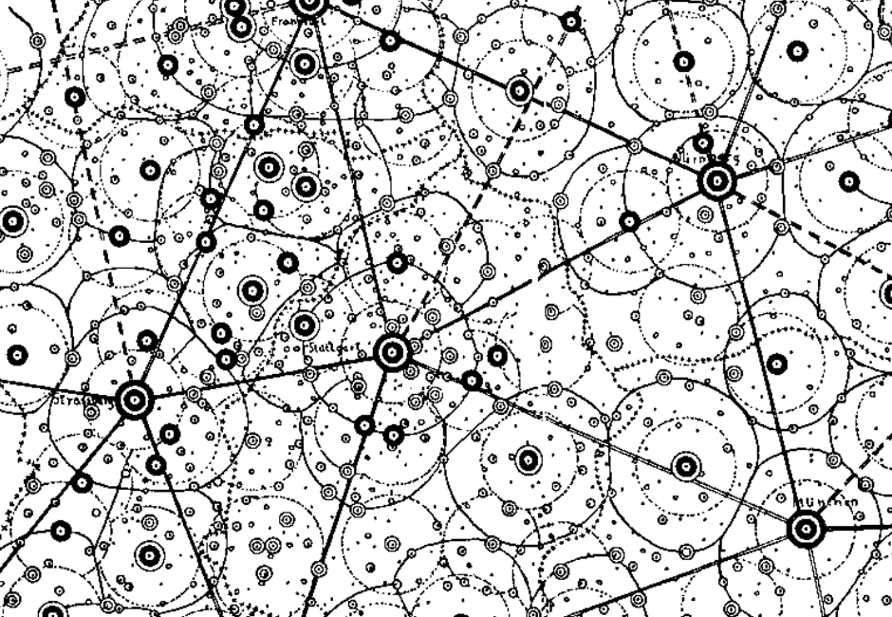
Scale
Integration
Mechanism
cognition & agency
life-course
human development
seeds of economic growth
$${10}^{9}$$
Individual
livability
safety
schools
billions
Neighborhood
neighborhood effects
cumulative (dis)advantage
$${10}^{6}$$
selection
segregation
mixing
inequality
millions
scaling and agglomeration
social + physical networks
economy, information, land uses
$${10}^{3}$$
City
thousands
migration
trade
laws of geography
gravity law, Zipf’s law
urban hierarchy
Urban Systems
Urban Theory

Slide 5
When a city doubles in size
its economic productivity per capita increases by 15%
Sveikauskas 1975
https://academic.oup.com/qje/article/89/3/393/1896685?login=true
Notes:
People have known about this type of effect, particularly in empirical economics, for a while but did not appreciate their generality to many quantities and constancy in terms of the values of the elasticities.

Slide 6
When a city doubles in size
its per capita violent crime increases by 16%
Glaeser & Sacerdote 1999
https://www.journals.uchicago.edu/doi/abs/10.1086/250109

Slide 7
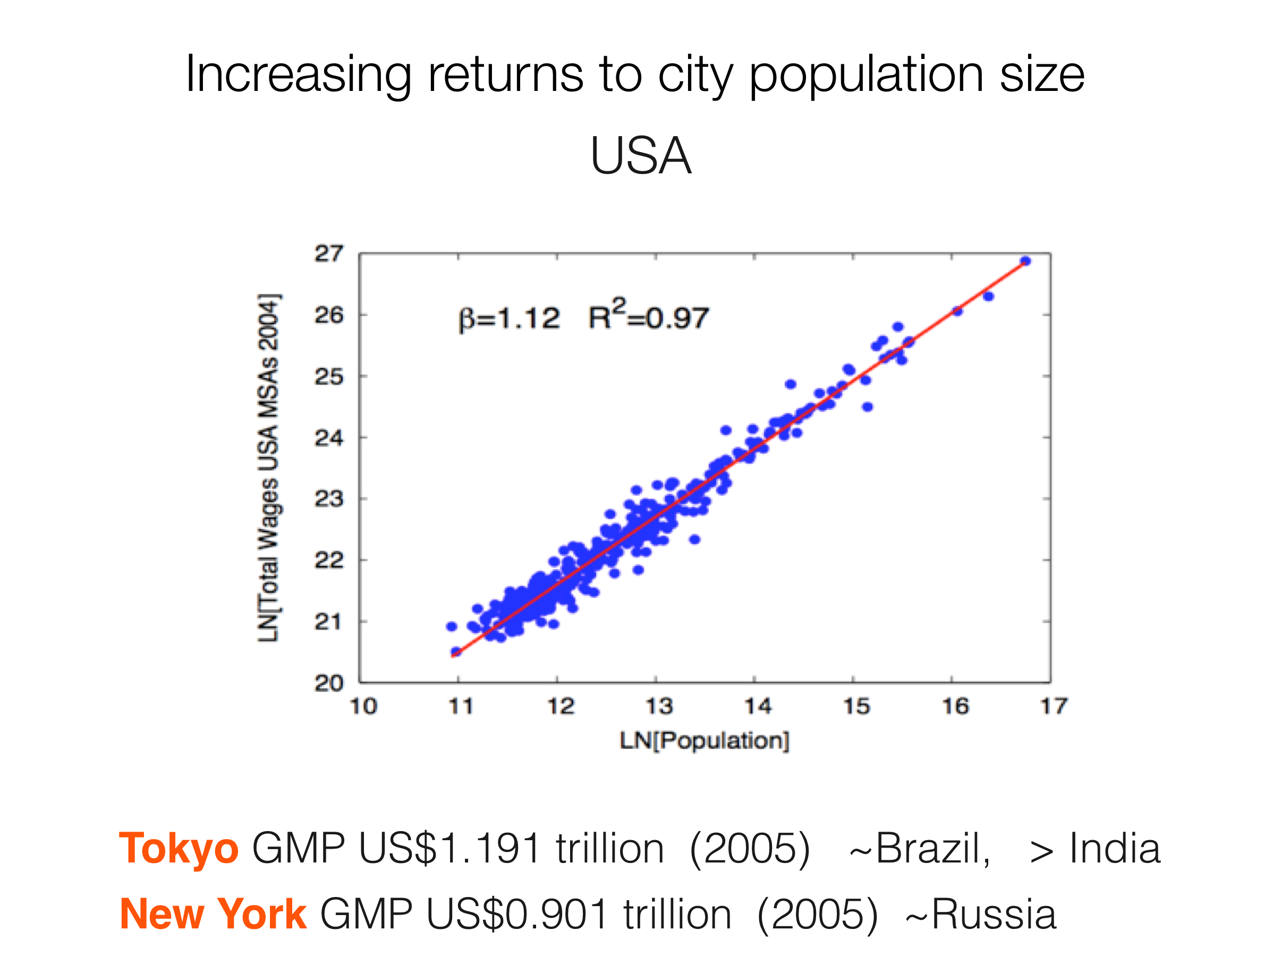
https://www.pnas.org/content/104/17/7301
When a city doubles in size its wages increase by 12%
Notes:
This is a little grainy but was one of the first scaling plots we did. Because the GDP per capita increases with city size, large cities such as Tokyo and NYC can her enormous economies comparable to entire large (poorer) nations.

Slide 8
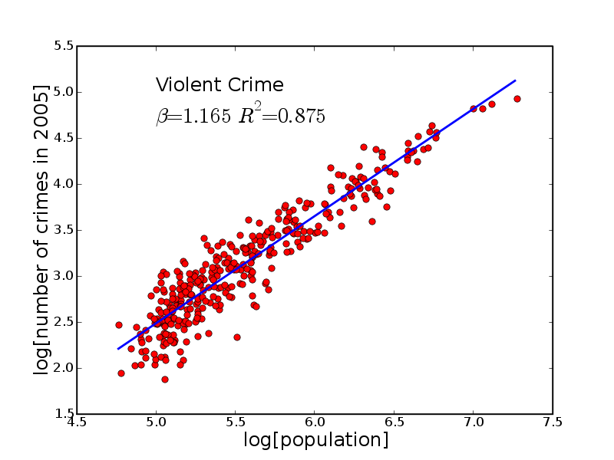
Violent Crime in US cities
When a city doubles in size its wages increase by 16.5%
https://www.pnas.org/content/104/17/7301
Notes:
But - critically - these properties do not just apply to economic quantities but in general to most socioeconomic rates (quantity per unit time), good and bad. Crime is an example, especially person on person crime.

Slide 9
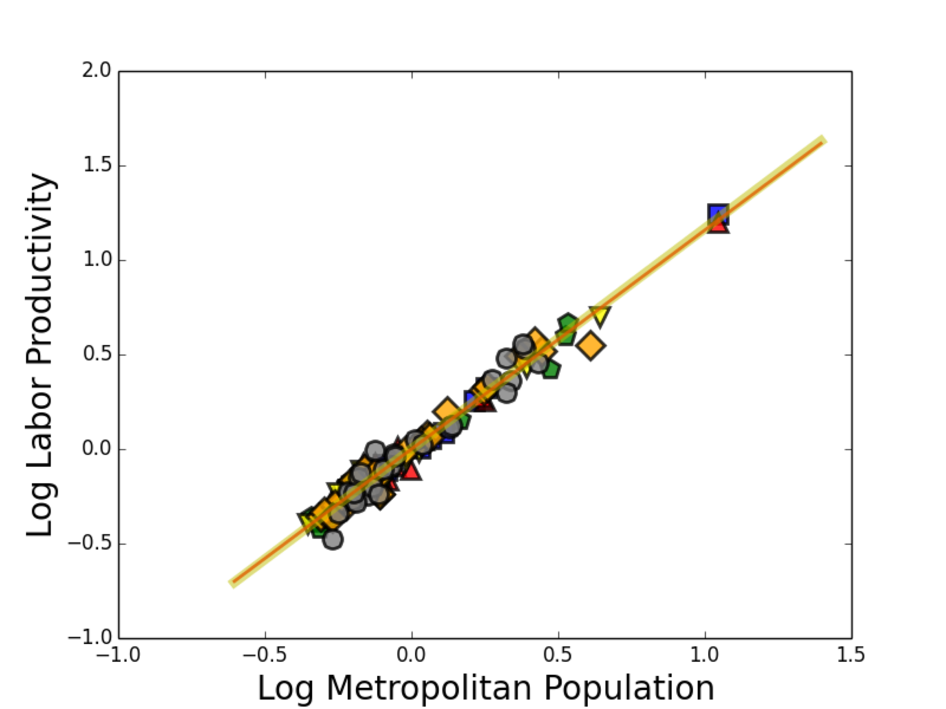

When a city doubles in size its labor productivity per capita increases by 16%
European Nations
β=1+1/6
https://royalsocietypublishing.org/doi/10.1098/rsif.2016.0005

Slide 10
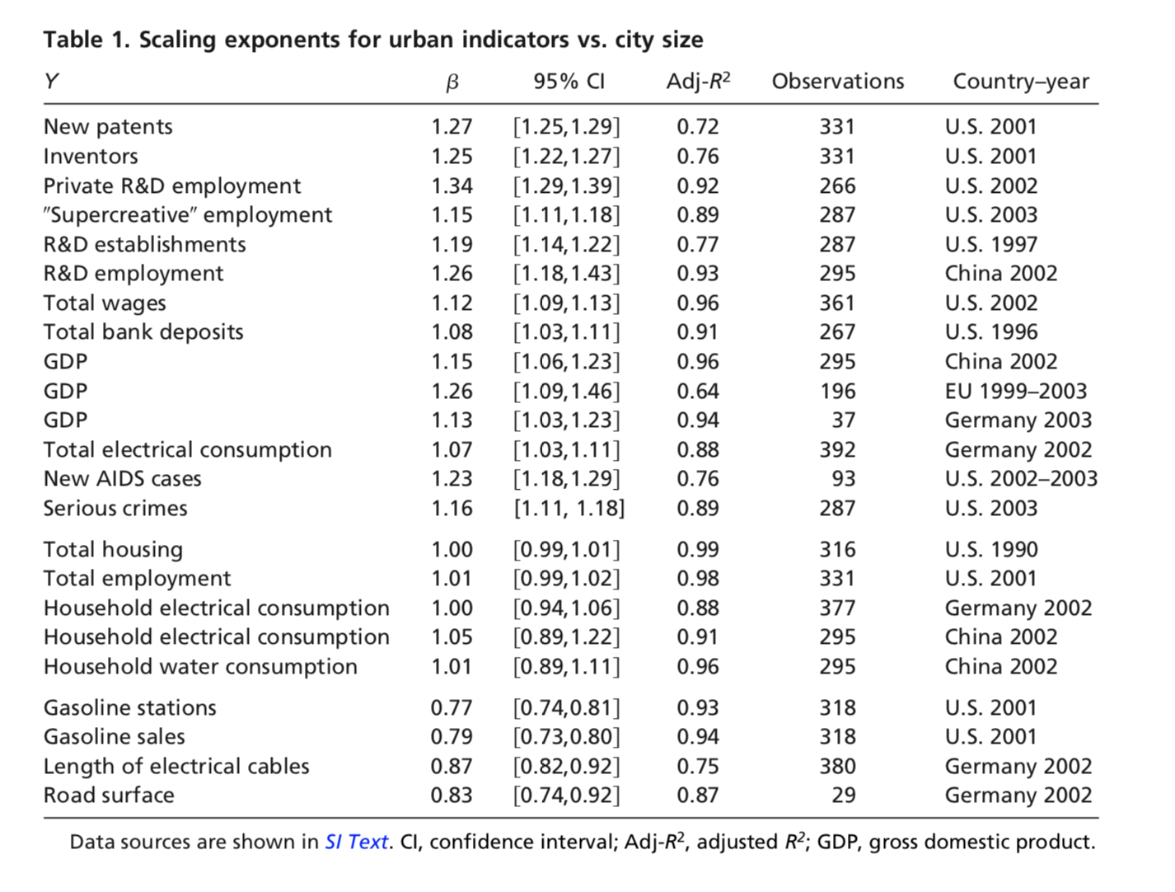
Notes:
This is relatively simple (from our 2007 PNAS paper) and shows a taxonomy of scaling, with socioeconomic quantities scaling super linearly, infrastructural sub linearly, and “personal needs” such as housing or number of jobs, linearly.

Slide 11
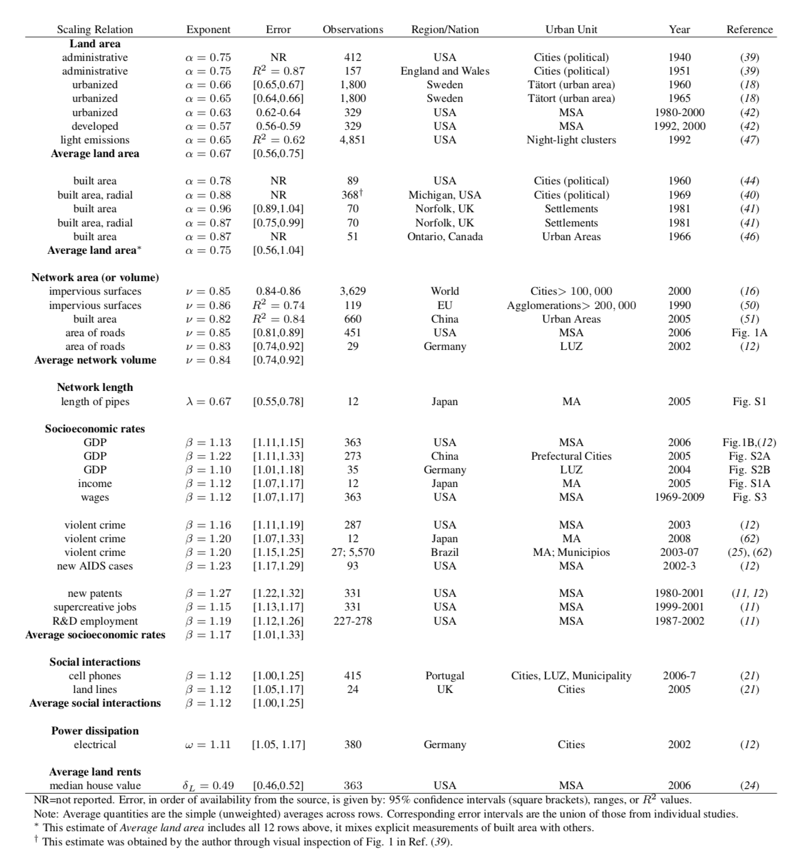
Urban Systems:
USA
European Union
Brazil
South Africa
Japan
China
India
…
Settlements:
Aztecs
Inka
Southwest Pueblo
Roman Empire
Medieval Europe
19th Century England
Different in:
- Hunter/Gatherer Camps
- Slums (informal settlements)
https://www.science.org/doi/10.1126/science.1235823
Notes:
This is from a more recent paper. Note the variety of quantities, nations and the fact that it applies to cities through out history. Note also that scaling of this type fails in some circumstances when we no longer have permanent settlements or when we have strong deficits of infrastructure (such as in slums). We will return to these points later.

Slide 12

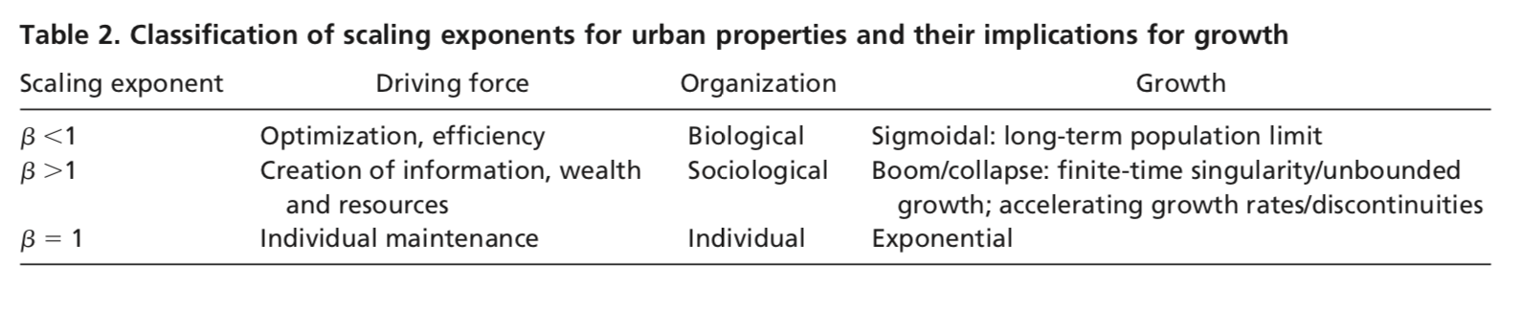
Summary of Exponents
https://www.pnas.org/content/104/17/7301
Notes:
This was a simple rational of the exponents, but we will do better as we develop theory to explain them.

Slide 13

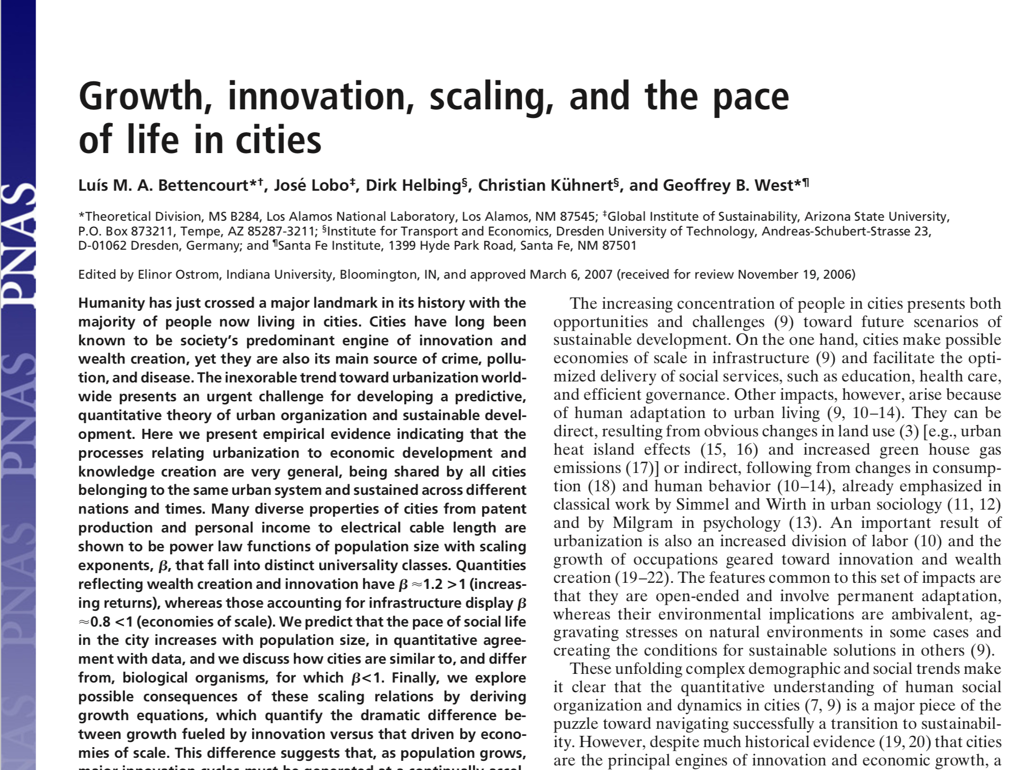
https://www.pnas.org/content/pnas/104/17/7301.full.pdf

Slide 14
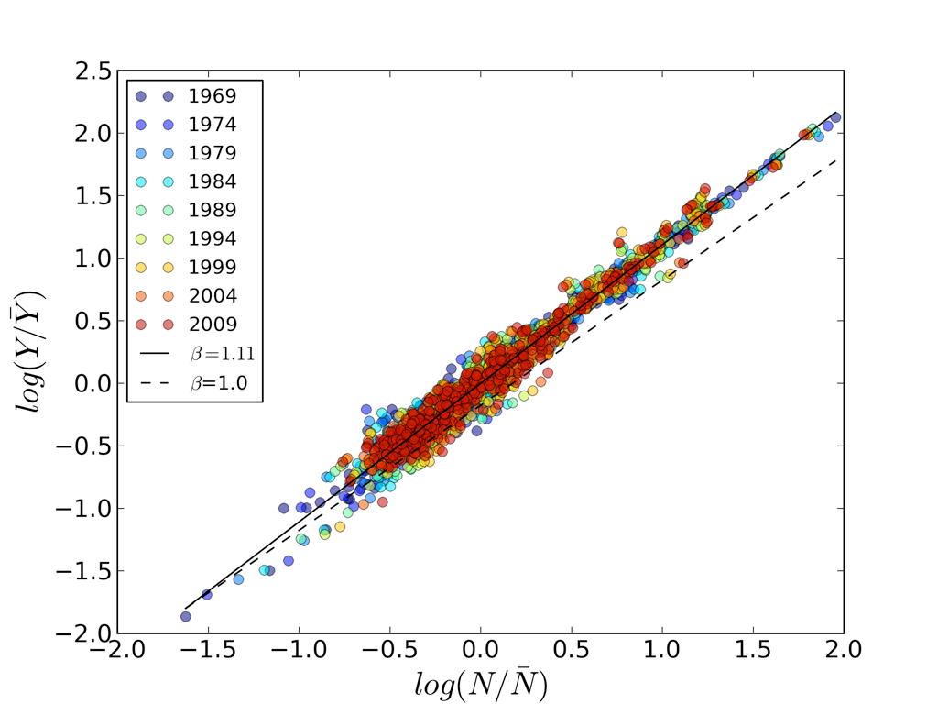
A law in time ...
Wages
US Metropolitan Areas
1969-2009
$$lnY(N)=lna+βlnN$$
https://www.pnas.org/content/pnas/104/17/7301.full.pdf
Notes:
Importantly, once we subtract over all growth (intercept common to all cities) and population growth common to all cities, scaling is conserved in time. That is, even as an urban system growth in population and over all economic size, the relation between cities is preserved.

Slide 15
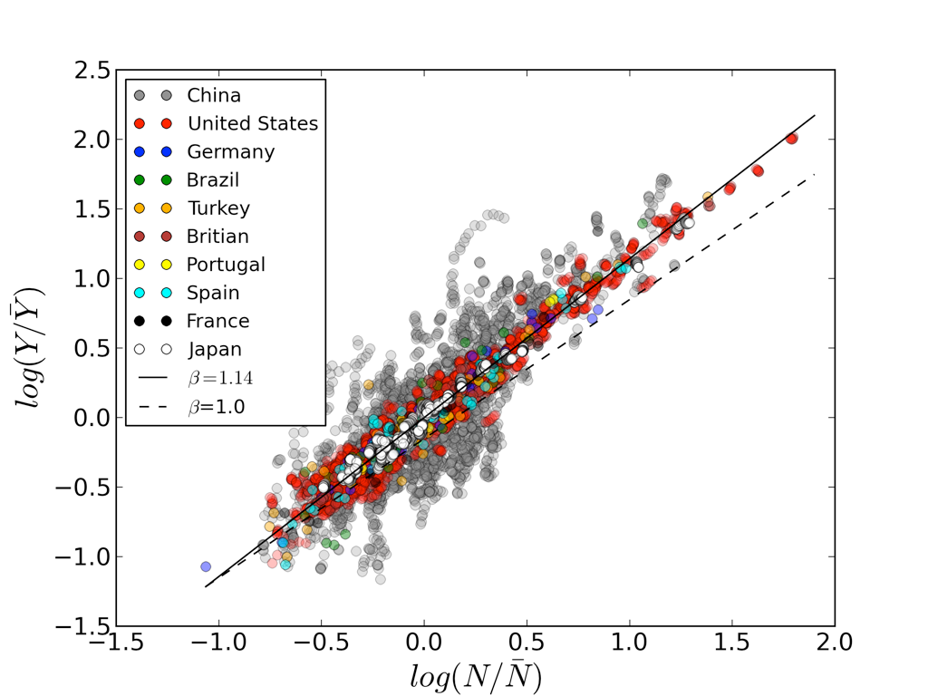
A law in across nations ...
Great Britain
GDP
cities in 10 nations
Notes:
Again here, I centered the data, by taking out overall size of the economies and population. All data sets are centered at (0,0).

Slide 16
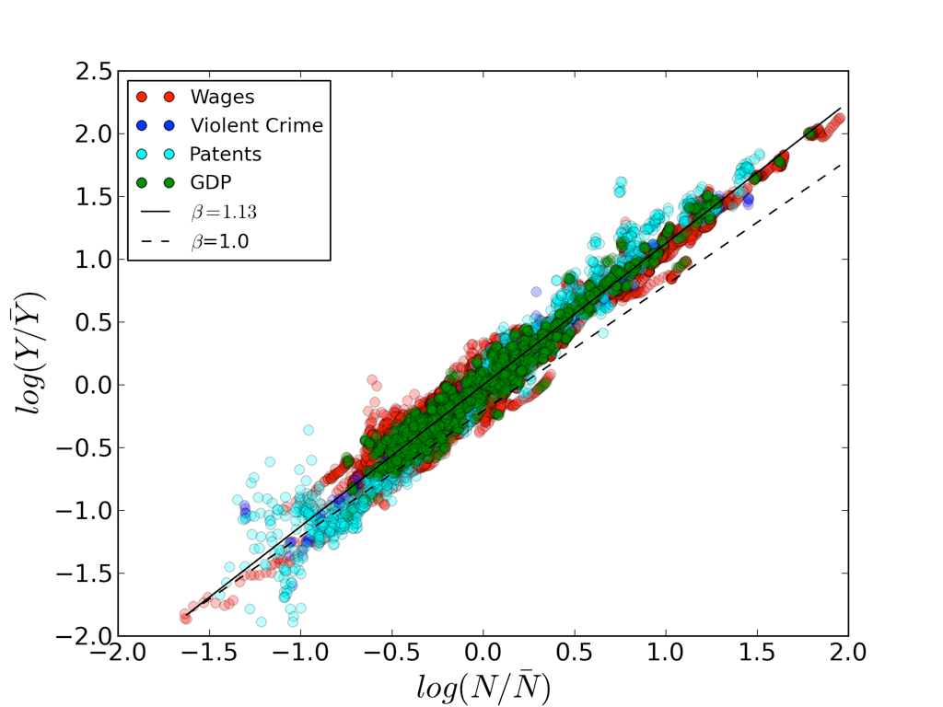
A law in across quantities ...
Wages, Crime, Patents, GDP
US Metropolitan Areas
A unified theory of urban living
https://www.nature.com/articles/467912a
Notes:
And the same centering for various socioeconomic rates.

Slide 17
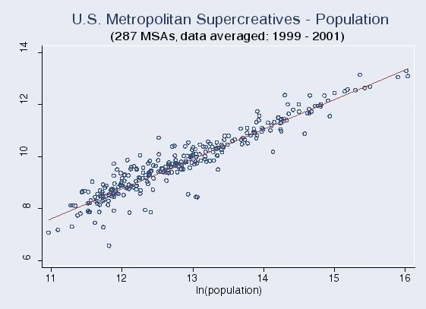
β=1.15 ( 95% C.I.=[1.11,1.18] )
adjusted R²= 0.89
Data courtesy of Richard Florida and Kevin Stolarick.
Supercreative Professionals [Florida 2002] are “Computer and Mathematical, Architecture and Engineering, Life Physical and Social Sciences Occupations, Education training and Library, Arts, Design, Entertainment, Sports and Media Occupations”.
Derived from Standard Occupation Classification System of the U.S. Bureau of Labor Statistics
https://www.sciencedirect.com/science/article/abs/pii/S0048733306001661?via%3Dihub

Slide 18
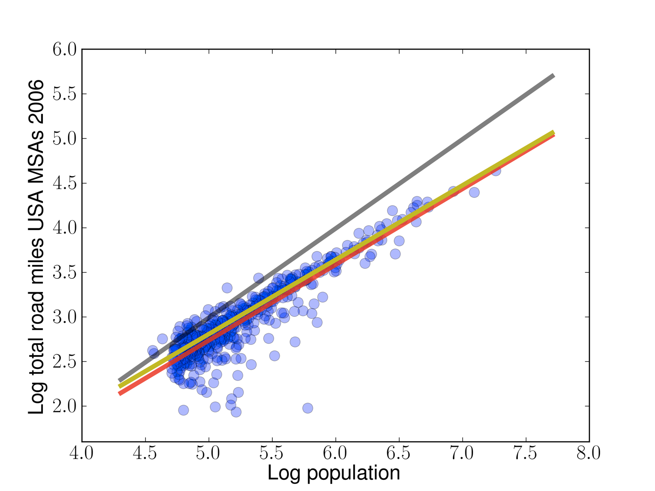
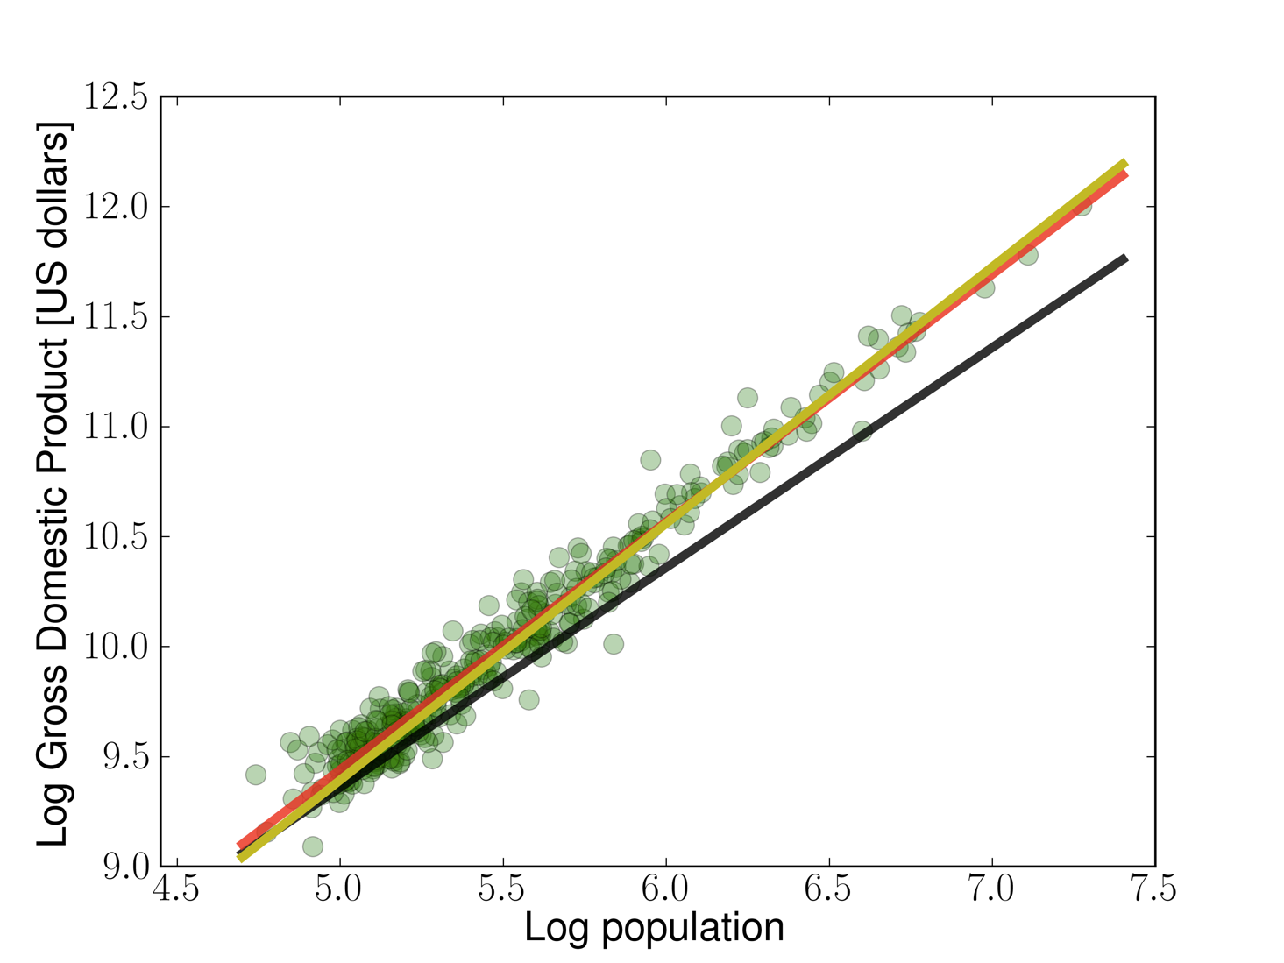
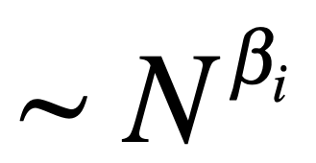
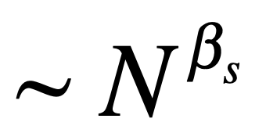
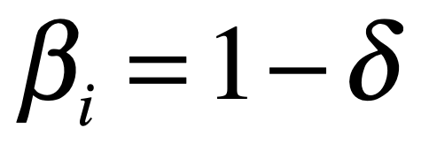
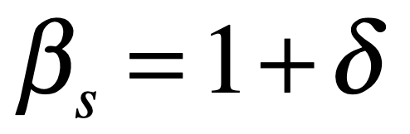
Infrastructure & socioeconomic rates
United States: Metropolitan Areas
𝜷i = 0.84±0.03
𝜷s = 1.13±0.03
Volume of Infrastructure
Social Outputs
$$δ≃1/6$$
The origins of scaling in cities
https://www.science.org/doi/full/10.1126/science.1235823
Notes:
This starts to notice that the values of exponents above and below 1, for socioeconomic rates and infrastructure volumes has complementary exponents, with the same deviation (above and below) 1. This is a hint for theory.

Slide 19
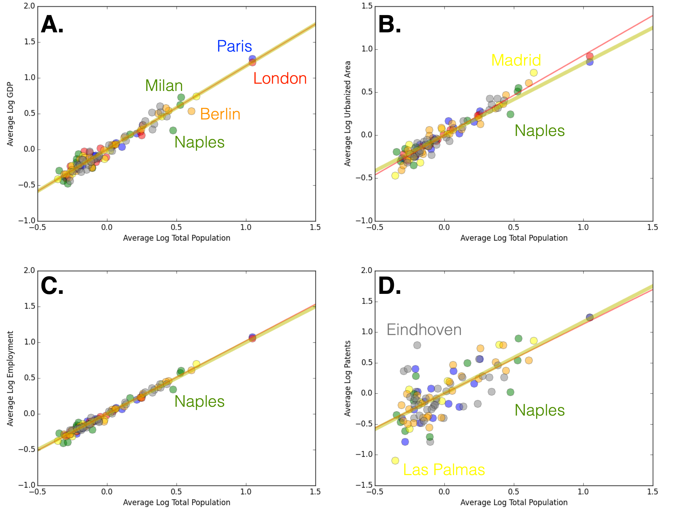


GDP
Urbanized Area
Urban Scaling in Europe
https://royalsocietypublishing.org/doi/10.1098/rsif.2016.0005
β=1+1/6
β=1-1/6
Metropolitan Areas in the European Union
Employment
Patents
β=1
Notes:
Same thing for Europe.

Slide 20
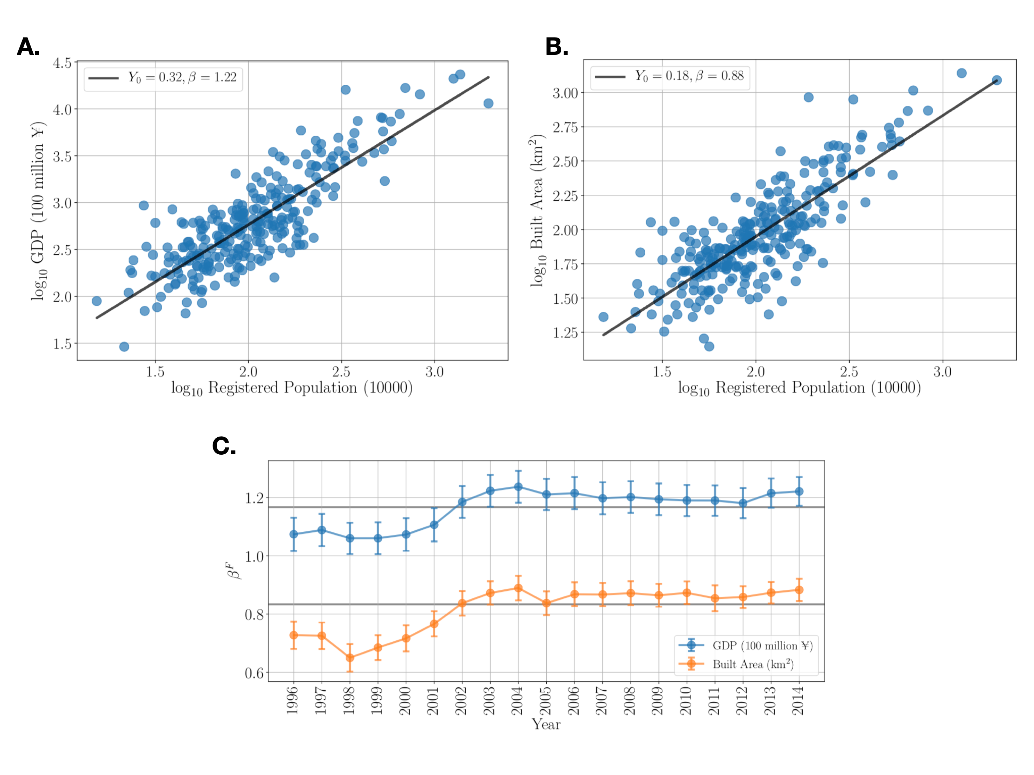
Prefectural Cities in China
Growth and development in prefecture-level cities in China
https://journals.plos.org/plosone/article?id=10.1371/journal.pone.0221017
Notes:
… and China.

Slide 21
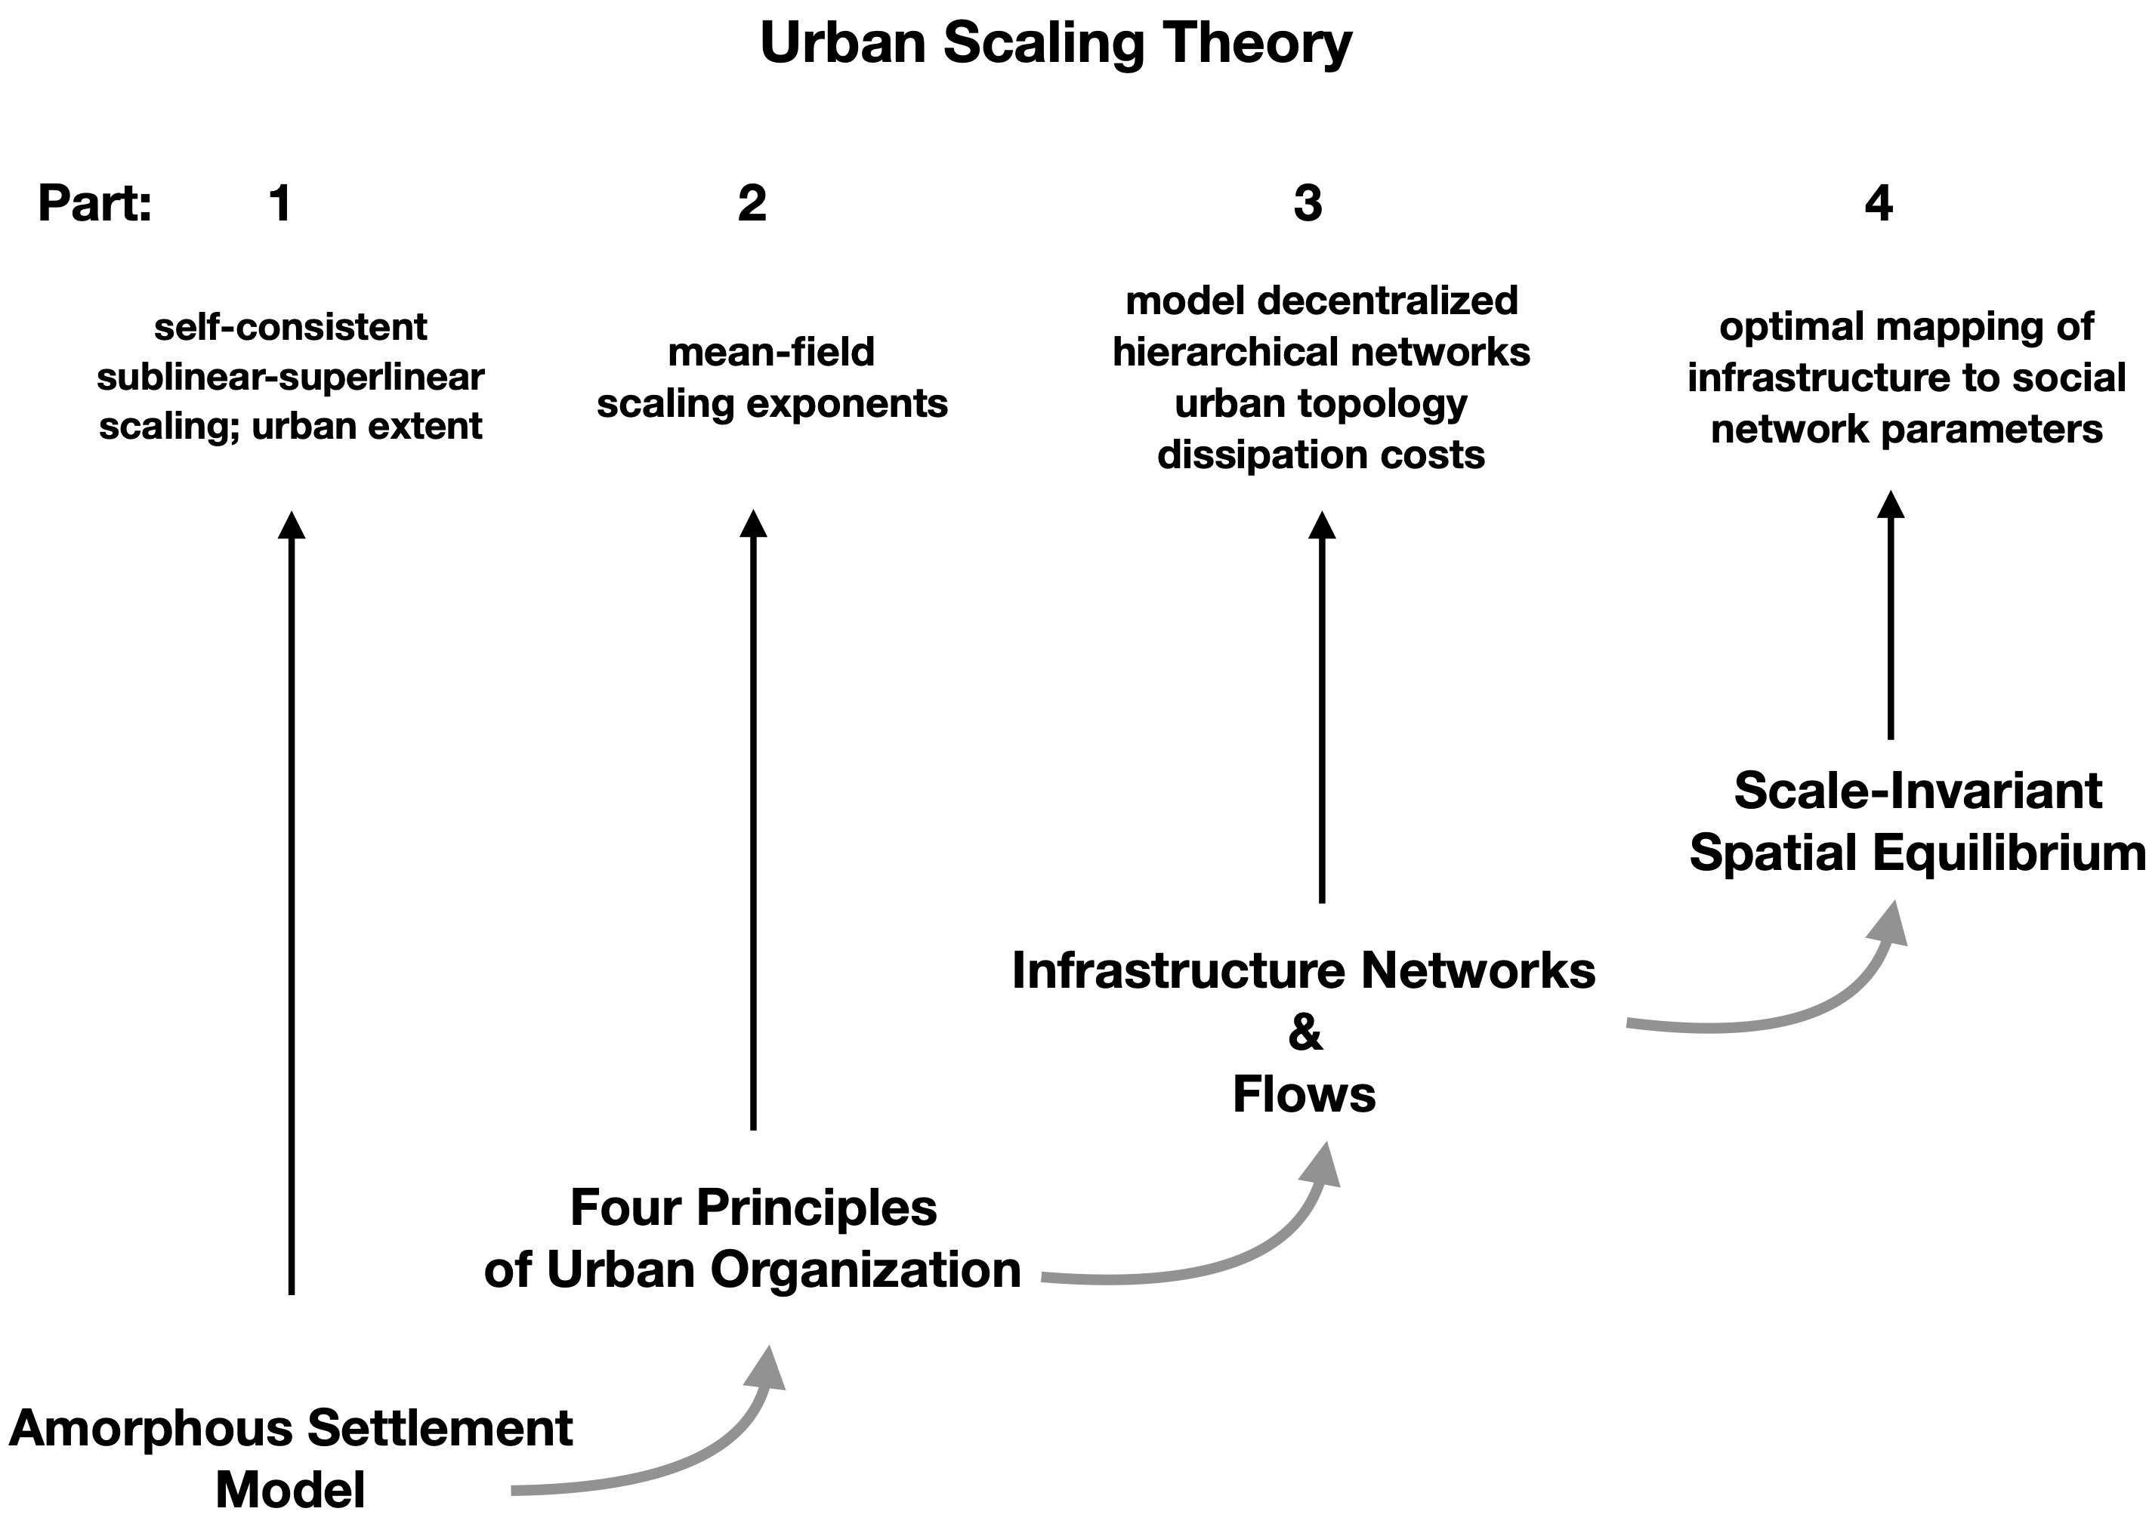
A roadmap for deriving the scaling properties of cities
IUS Figure 3.5
Notes:
This is the road map now for developing a network theory that will derive the values of the observed exponents.

